Slide 1
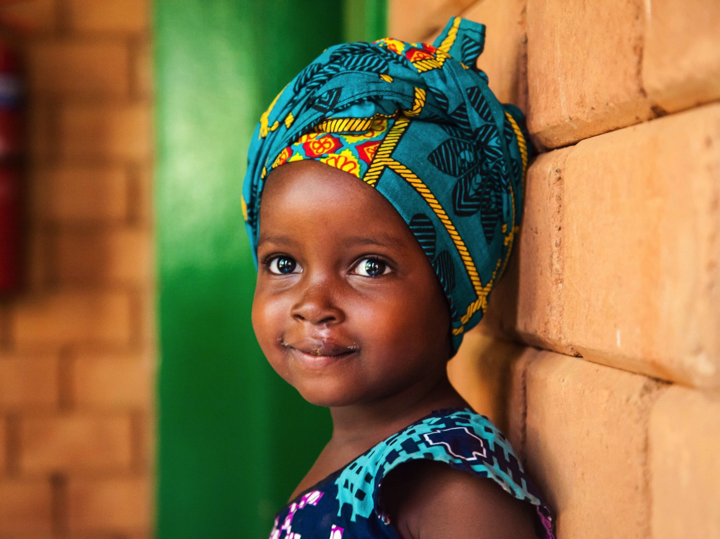
Smile Session #3
Thriving Smile Train Kenya
Notes:
Hello everyone! Welcome to Smile Session #3. The subject of today’s lesson is Thriving and Smile Train Kenya.
This webinar can be shown to students between the ages 8 to 12 directly or can serve as a lesson guide for parents or teachers of younger or older students. There is a supplementary lesson guide packet that can be utilized to bolster this content.

Slide 2
Disclaimer
The information provided in this webinar is meant to be helpful to you and is for informational purposes only. The information contained here should not be relied upon for any specific purpose or used as a substitute for medical advice. While we attempt to thoroughly address specific topics, it is not possible to address every unique situation. Please consult a professional with any questions you might have. Although we attempt to provide accurate and up-to-date information, we make no guarantee to that effect and are not responsible for the content of these resources. All liability with respect to actions taken or not taken based on the contents of the webinar are hereby disclaimed. The content is provided “as is” and no representations are made that the content is error-free.

Slide 3
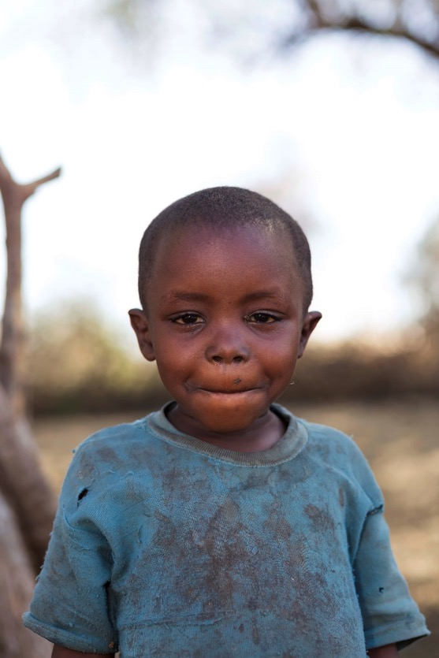
Lesson Objectives
Encourage children to think critically and creatively about the things they need to thrive
Reinforce that everyone has the same fundamental needs around the world, no matter which country they live in
Introduce some of Smile Train’s activities that help kids to thrive
Notes:
The goal of this webinar is to run through a lesson plan that accomplishes the following objectives:
Encourage children to think critically and creatively about the things they need to thrive
Reinforce that everyone has the same fundamental needs around the world, no matter what country they live in
Introduce some of Smile Train’s activities that help kids thrive

Slide 4
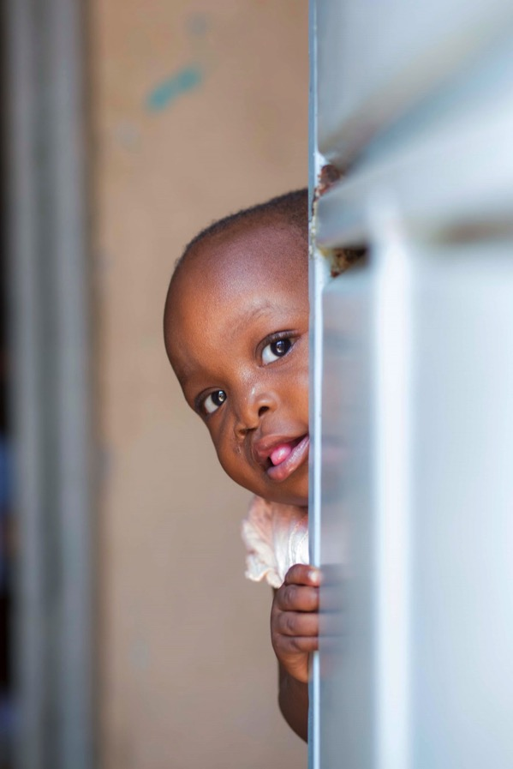
Lesson Information
Background
Making Connections
Activity
Notes:
This lesson is split into three sections; background, making connections, and a fun activity! We will first go through some background information on our basic fundamental needs, as well as what things we need to thrive and why these are important to our work in Kenya.

Slide 5
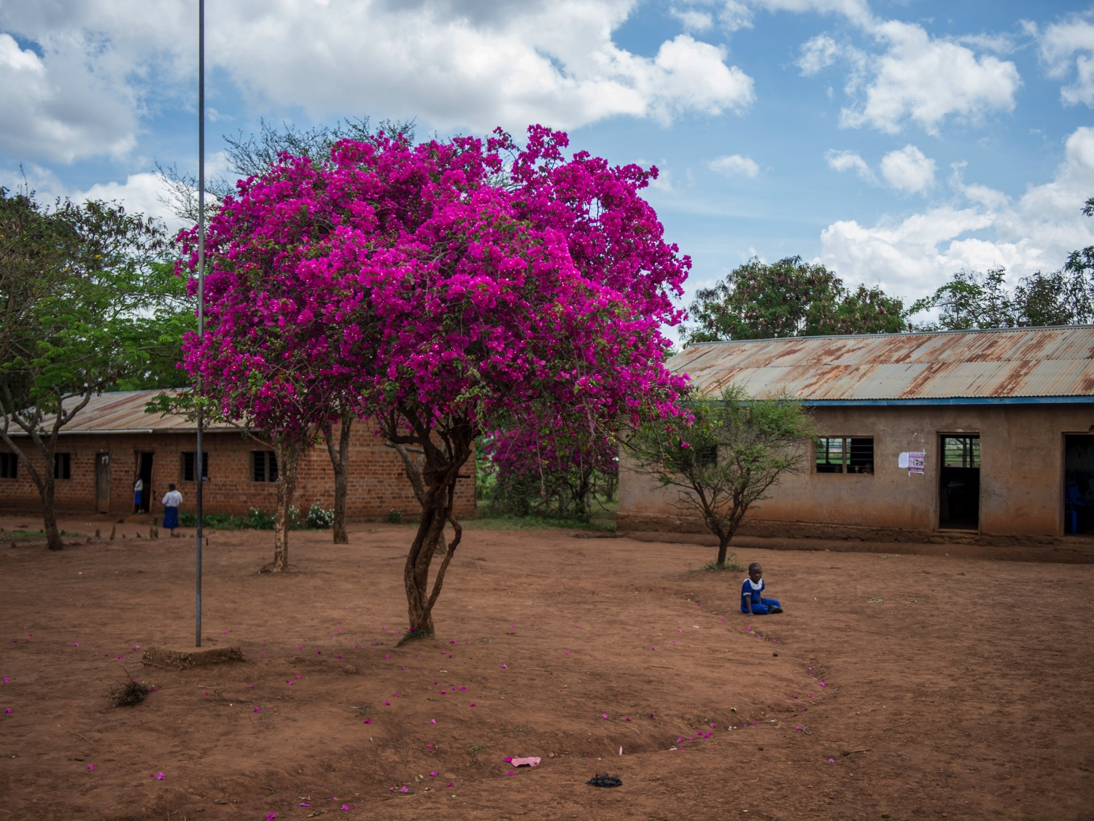
Background

Slide 6
What do we need to survive?
Air
Food
Water
Shelter
Medicine
Sleep
Notes:
Let's talk about our basic needs! There are a lot of things that all humans need in order to survive.
We need:
Air- Air contains oxygen, which we need for our bodies to function.
Food- Food is important because it gives us the nutrients to grow big and strong. Food gives us energy and keeps us healthy.
Water- Water helps to keep your body functioning and keep you healthy.
Shelter- Shelter protects us from the elements and allows us to stay safe, rest, and have a comfortable place to sleep, eat, learn, and play in.
Medicine- Medicine helps us recover when we're sick! Medicine cures us of illnesses and helps us get back to being healthy again.
Sleep- Sleep is very important! Everyone needs rest, so it's important to get a good night's sleep every night. This allows our bodies to re-energize and prepare us for the next day.

Slide 7

What does it mean to thrive?
Security
Belonging
Respect
Notes:
Now that we know what we need to survive, let's talk about what helps us thrive!
Security- Security can be physical security, the freedom from bodily harm. It can also mean freedom from being bullied or the knowledge that our basic needs will be taken care of in the future.
Belonging- Humans need to feel a sense of belongingness and being accepted socially. Without this people can feel isolated and lonely. This need can be fulfilled by friends, family, and community
Respect. We need to feel respected by others and to have respect for ourselves. Building confidence, participating in hobbies, and learning new things can all help a person fulfill these needs.
By focusing our energy on security, belonging, and respect, we can thrive!

Slide 8
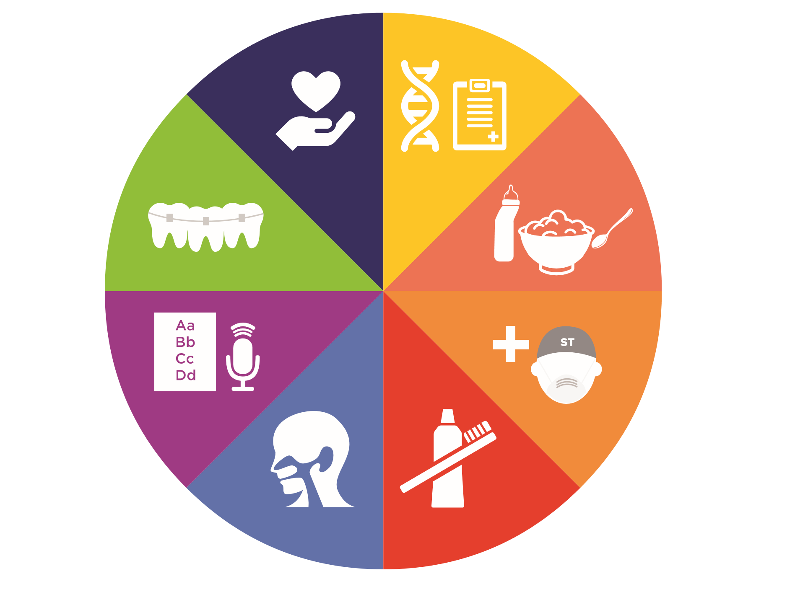
Smile Train helps kids thrive
Notes:
How does Smile Train help kids thrive?
Our programming goes beyond a simple surgery.
The journey to living a healthy life for a child with a cleft starts with a smile, but that is only the beginning. Smile Train-supported comprehensive cleft care includes diagnosis, feeding and nutrition, dental care, ENT care, speech services, orthodontics, counselling and support. Smile Train gives a child access to a full range of cleft treatment services they would otherwise never receive and ultimately the opportunity to thrive.

Slide 9
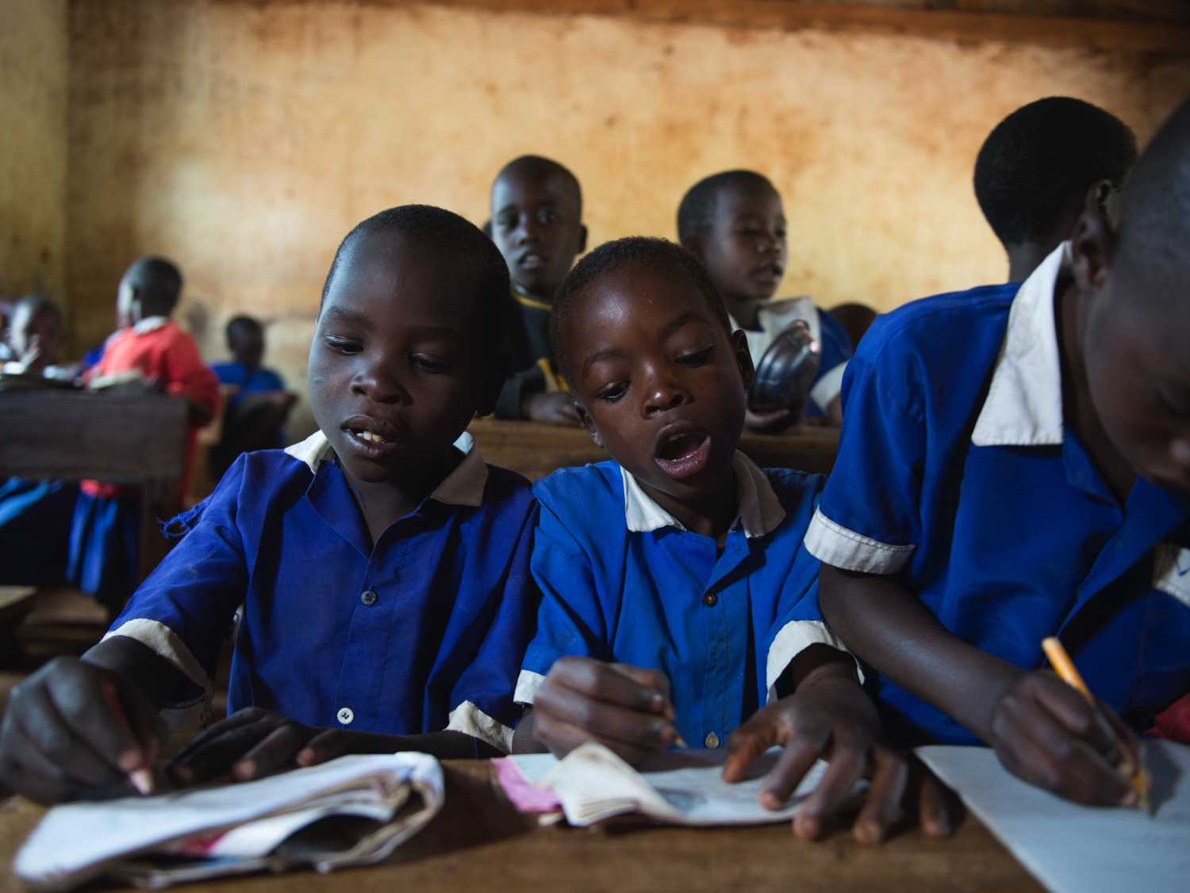
Making
Connections

Slide 10
Smile Train Kenya Background
Smile Train Kenya was established in 2002
We currently work with 28 partner hospitals
10,000 Smile Train-supported cleft treatments​

Slide 11
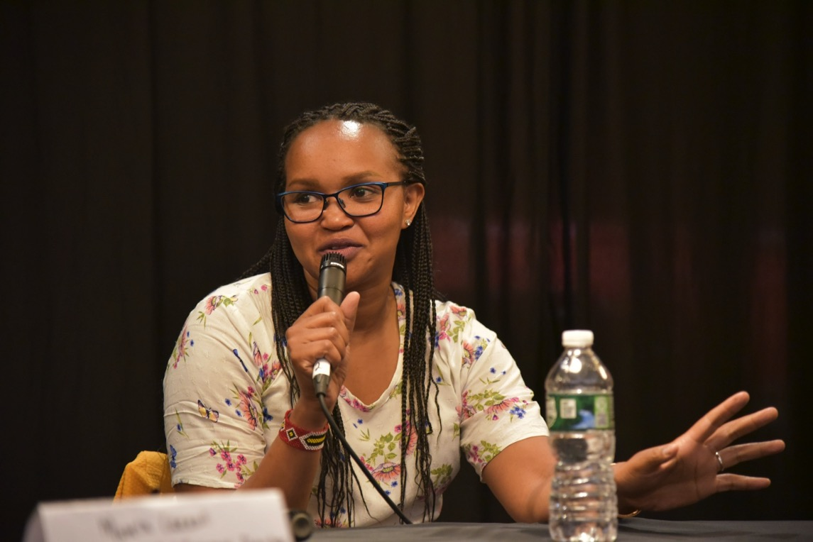
Jane Video
Notes:
Meet Jane! Jane is Smile Train's Program Director of East Africa.

Slide 12
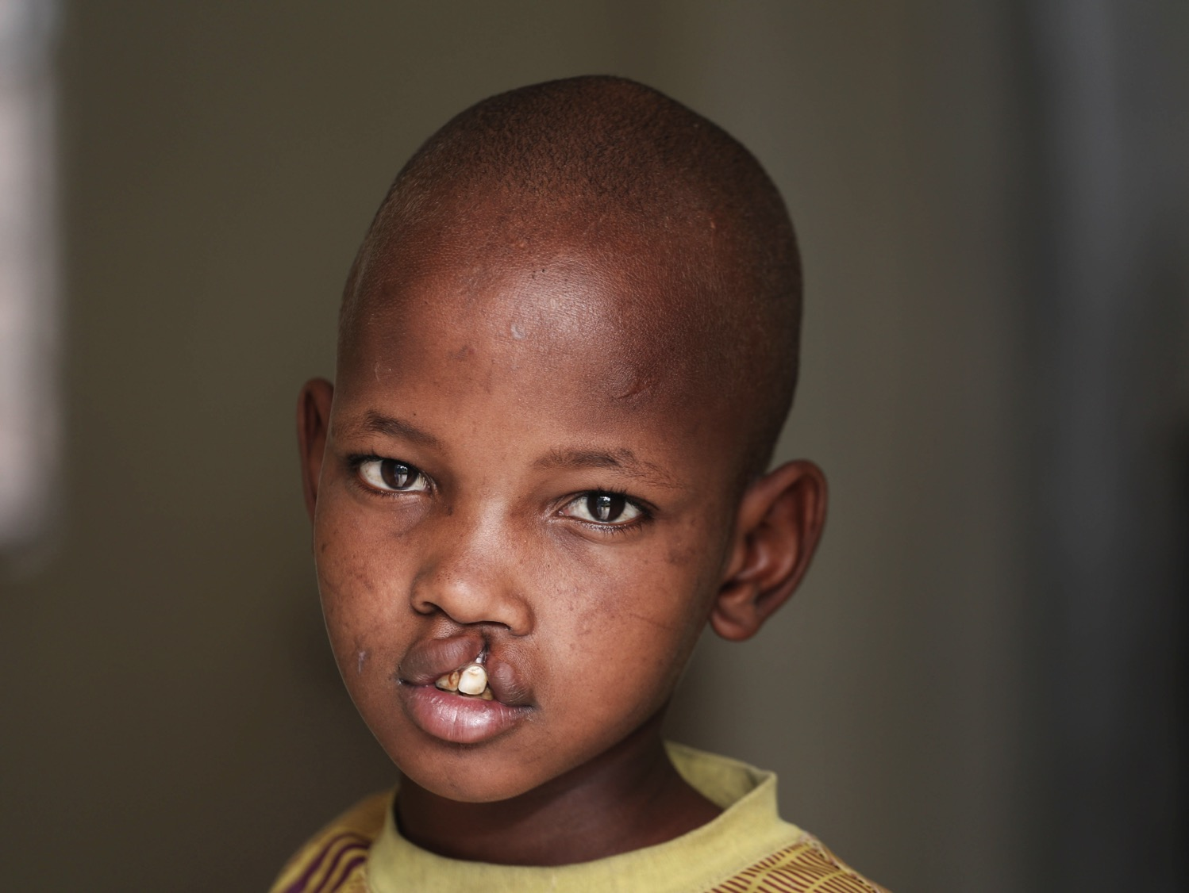
Johana’s Story
Notes:
Likanto was heartbroken when her sixth child, Johana, was born with a cleft lip. Likanto had never seen a baby with a cleft before in her small village in southern Kenya and was concerned for his future.
When the time came and Johana was old enough to go to school, he was excited. However, his excitement quickly turned to sadness. The other children teased him and called him awful names because of his untreated cleft lip. The constant teasing at school led Johana to begin covering his mouth whenever he was out in public.
Johana became increasingly shy. He always sat alone and never participated in class or talked to his classmates. His silence made his teachers incorrectly think that he had a learning disability.

Slide 13
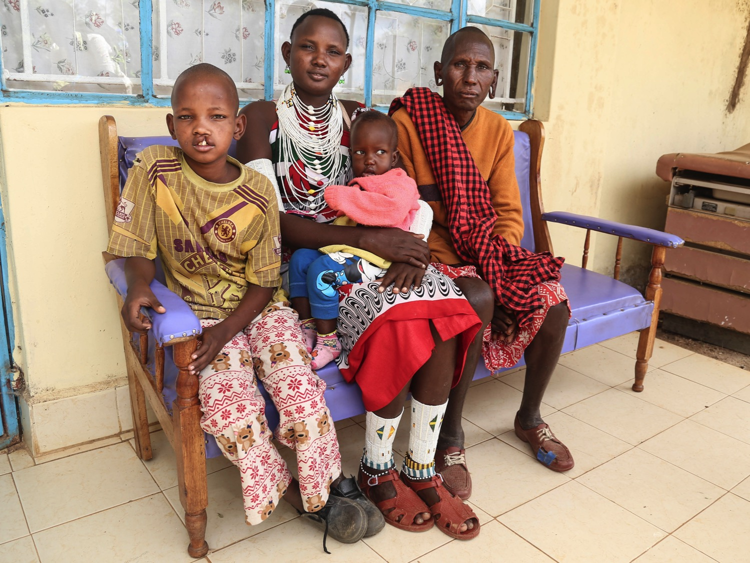
Johana’s Story
Notes:
Then one day, Johana’s family heard from a community health worker that an organization called Smile Train supported free surgeries and related treatment for children with clefts.
Likanto immediately brought Johana to the nearby Smile Train partner hospital. Johana was scheduled for surgery and once his cleft lip was successfully healed, Johana could not contain his joy.

Slide 14
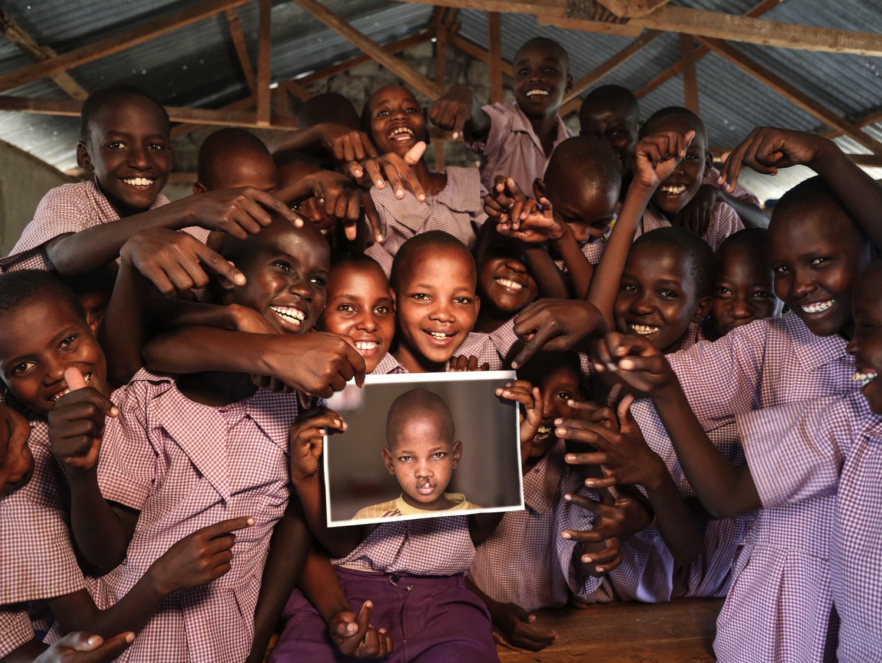
Johana’s Story
Notes:
With newfound confidence, Johana’s energy and smarts have made him the star of his village and his school. He was recently ranked among the best students in his class and even elected class president by his peers!

Slide 15
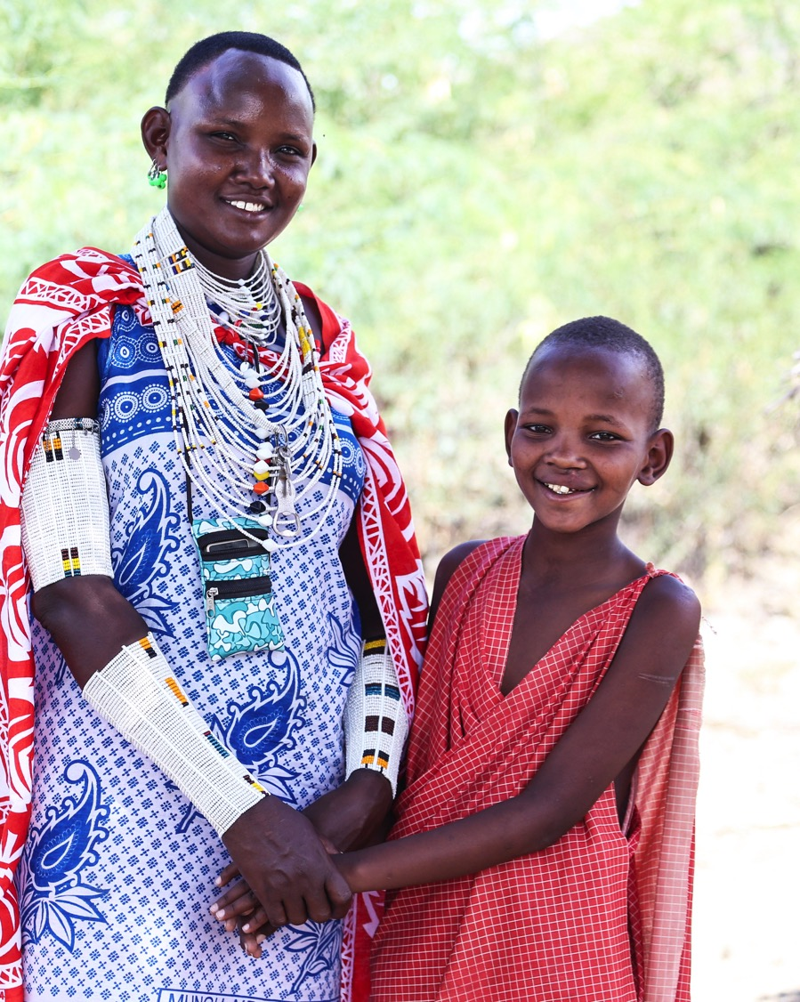
Questions for Connection
What does everyone need to survive?
How does Smile Train help kids thrive?
Where is Johana from?
What are some things that help you thrive?
How do people in your life help you thrive?

Slide 16
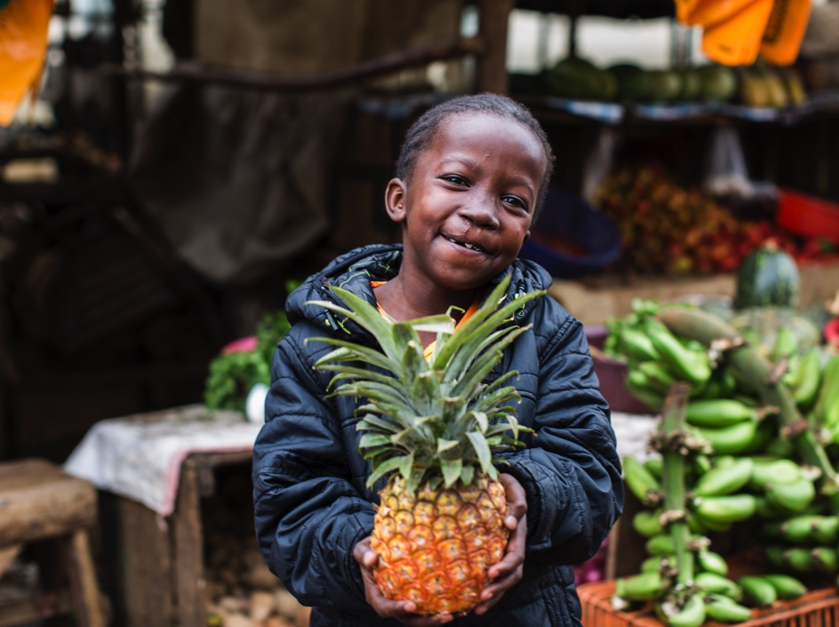
Activity
Notes:
Now that we’ve learned all about our essential needs, Kenya, and the work that Smile Train does in Kenya, let’s do a fun activity!

Slide 17
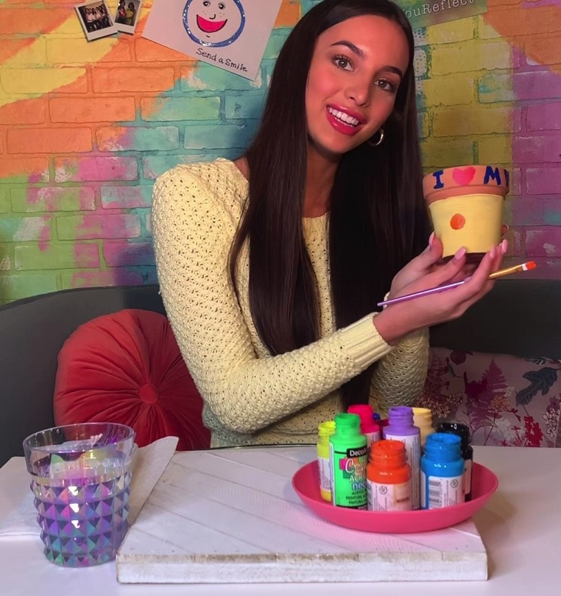
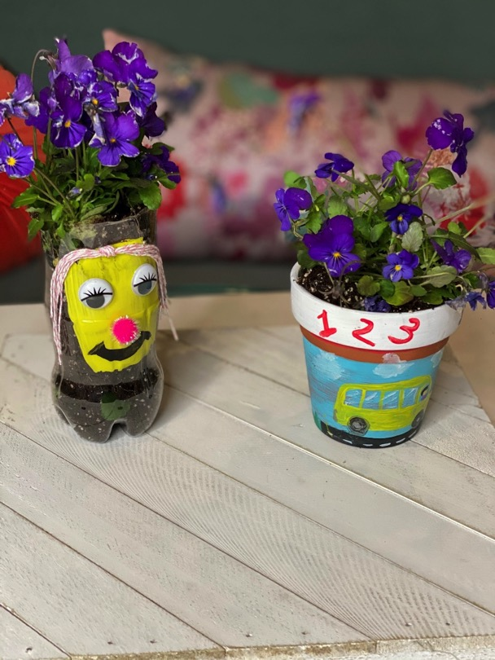
Activity
Notes:
Today, you’ll be decorating your own planters with Ms. Teen Illinois Victoria! If you don’t have a planter, that’s no problem at all. You can also use an empty jar or can. You’ll need things to decorate this with, so grab some paint and paintbrushes, colored pencils, markers, stickers, or anything else you’d like to decorate with.

Slide 18
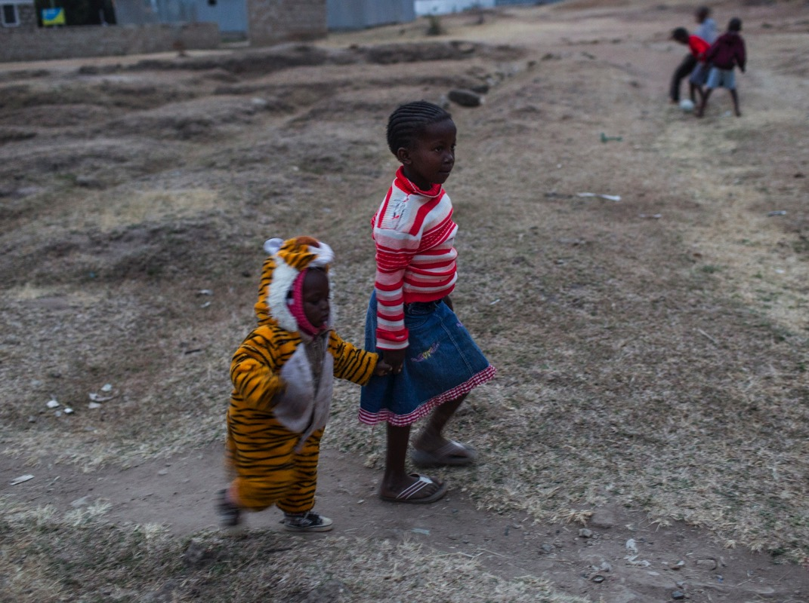
Thank You for joining us!

Slide 19
Sources
CommonLit Staff. Masolow’s Hierarchy of Needs. (2015). https://www.commonlit.org/texts/maslow-s-hierarchy-of-needs
Smile Train. Main Website. https://www.SmileTrain.org

