Slide 1
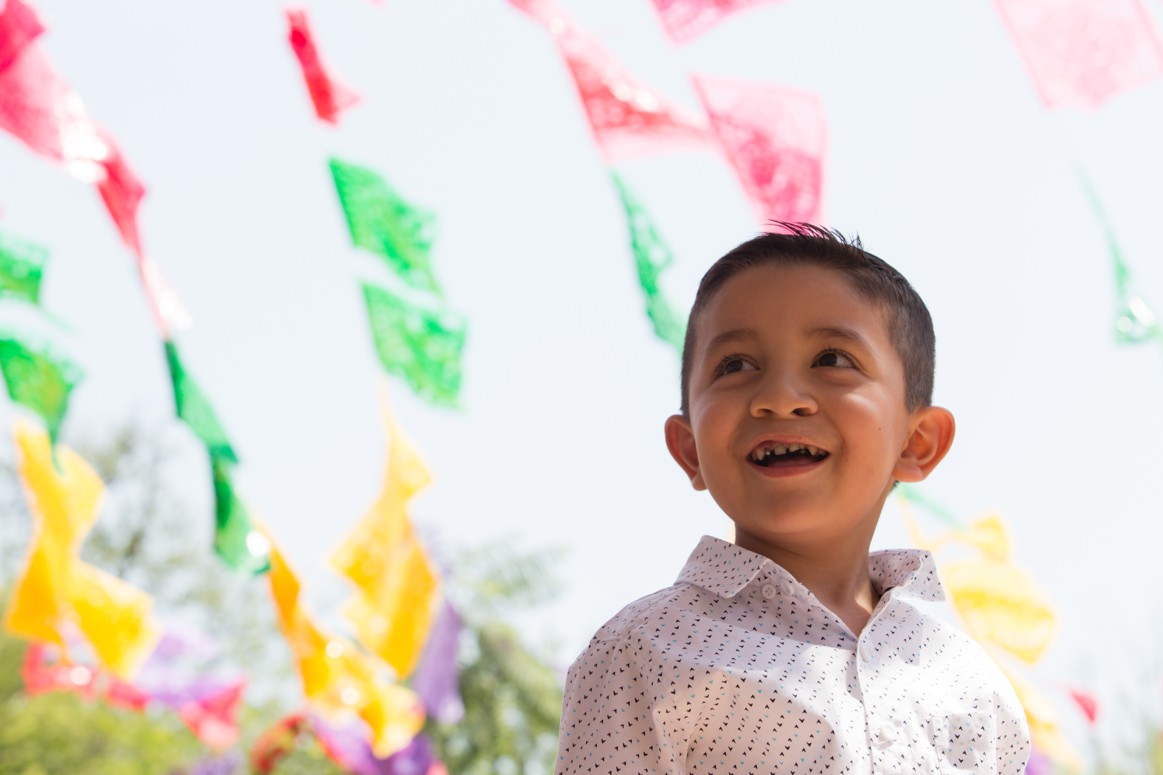
Food For Thought
Smile Train Mexico
Smile Session #1
Notes:
Welcome to Smile Session #1. These lessons were created for older elementary students and younger secondary students, those in grades 4-7, but with only minor edits, the content can be taught to younger or older students. The subject of today’s webinar is Nutrition and Smile Train Mexico. This webinar can be shown to students between the ages 8 to 12 directly or can serve as a lesson guide for parents or teachers of younger or older students. There is a supplementary lesson guide packet that can be utilized to bolster this content.

Slide 2
Disclaimer
The information provided in this webinar is meant to be helpful to you and is for informational purposes only. The information contained here should not be relied upon for any specific purpose or used as a substitute for medical advice. While we attempt to thoroughly address specific topics, it is not possible to address every unique situation. Please consult a professional with any questions you might have. Although we attempt to provide accurate and up-to-date information, we make no guarantee to that effect and are not responsible for the content of these resources. All liability with respect to actions taken or not taken based on the contents of the webinar are hereby disclaimed. The content is provided “as is” and no representations are made that the content is error-free.
Notes:
Disclaimer, read first line.

Slide 3
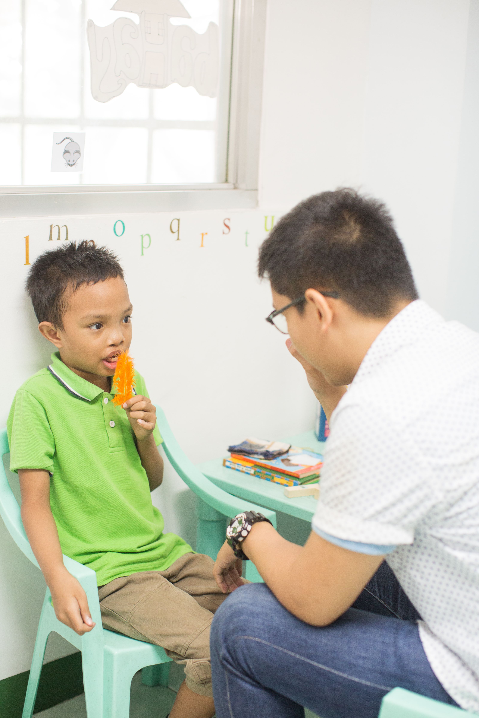
Lesson Objectives
Teach kids about healthy eating and the benefits of balanced nutrition
Create awareness about different cultures
Introduce students to the concept of cleft care and how nutrition is a vital component of that strategy
Notes:
The goal of this webinar is to run through a lesson plan that accomplishes the following objectives:
Teach kids about healthy eating and the benefits of balanced nutrition
Create awareness about different cultures
Introduce students to the concept of cleft care and how nutrition is a vital component of that strategy

Slide 4
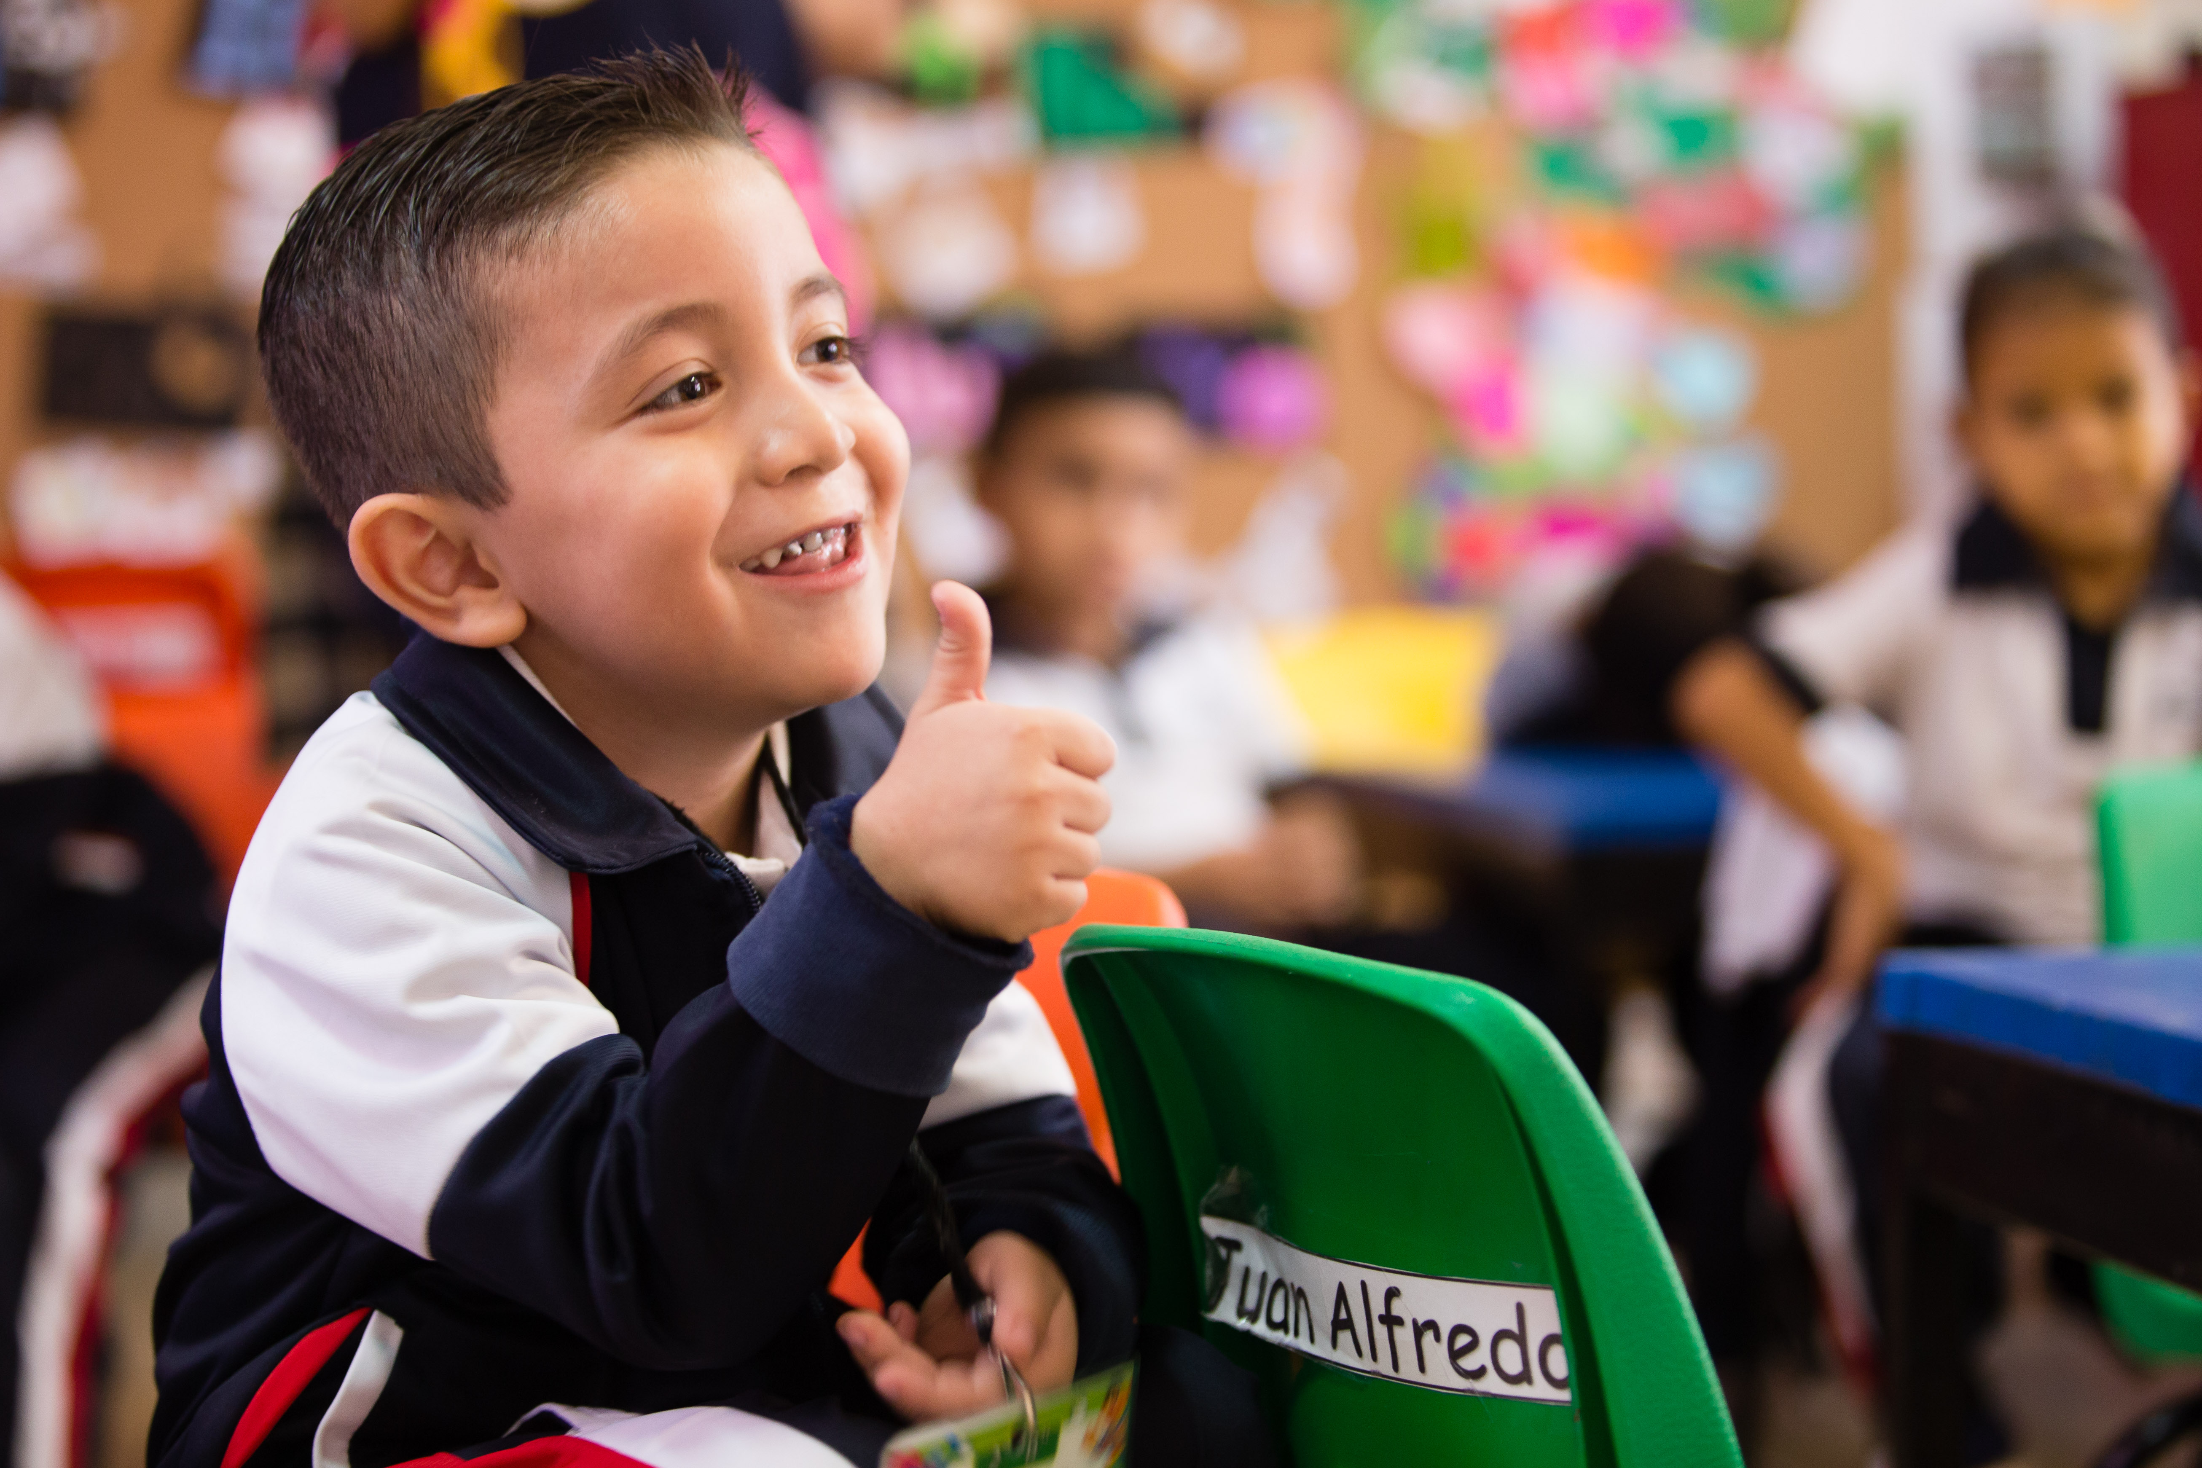
Lesson Information
Background
Making Connections
Activity
Notes:
This lesson is split into three sections; background, making connections, and a fun activity. We will first go through some background information on Nutrition, Smile Train, and how nutrition is an important part of cleft care. We will follow that with the making connections section, where we will reinforce information provided in the background section and to encourage students to think about the impact of nutrition on their lives and the lives of our patients. In this section we will play a video from one of our incredible staff members, Monica. She will do a deep dive into our programming in Mexico and the challenges our patients face. She will also do a quick food-themed Spanish lesson. After Monica’s video we will pose a series of questions for the students. Answers are either in the lesson guide packet or derived from student opinions. The final section is a fun activity that the students can participate in! We will be making healthy fruit popsicles with the help of two of our Student Ambassadors.

Slide 5
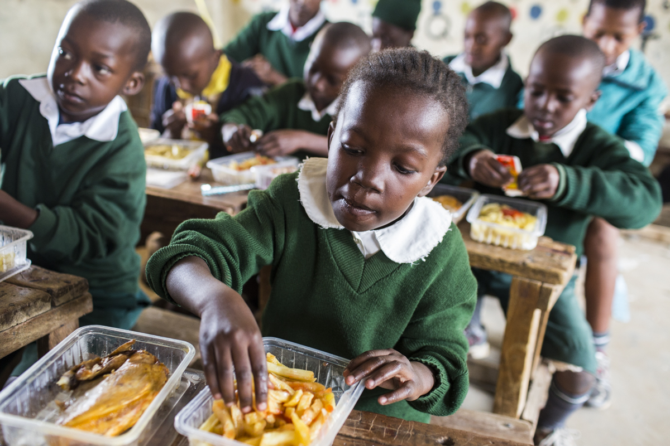
Background
Notes:
This section will provide background information on nutrition, Smile Train programming, and Smile Train’s activities in Mexico.

Slide 6
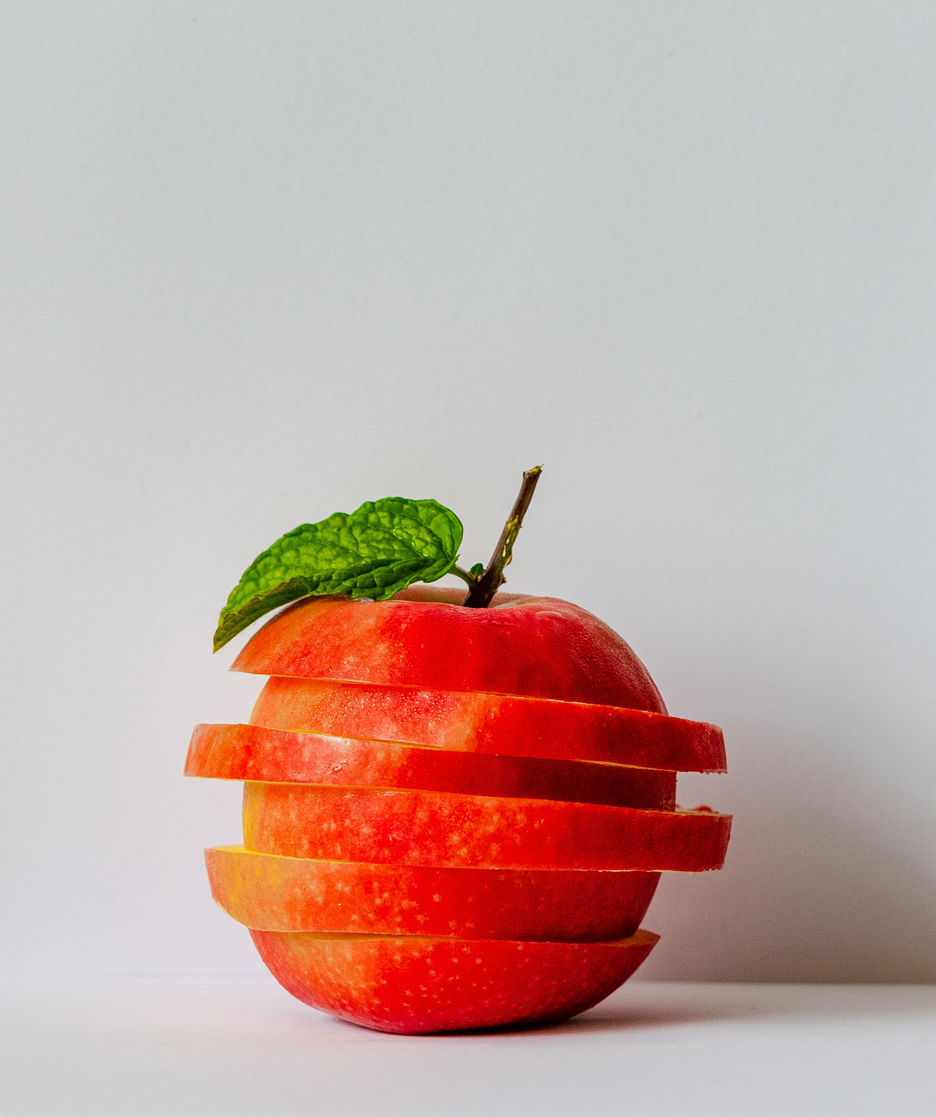
Good nutrition helps us grow big and strong!
We need 6 types of essential nutrients
Water
Protein
Fats
Carbohydrates
Vitamins
Minerals
Notes:
We need to eat healthy food to become big and strong. It is especially important for kids because they are still growing. The body needs six different types of essential nutrients – water, protein, fats, carbohydrates, vitamins, and minerals. Your body is made of water. We need it to maintain our organs and bodily functions and to regulate our body’s temperature. Nutrients like Protein and Carbohydrates give us energy, so we can learn and play! Vitamins and minerals keep our immune systems working, help us heal wounds, and keep our bones healthy, among a wide range of other functions and benefits.

Slide 7

There are three types of Macronutrients
Protein
Carbohydrates
Fats
Notes:
Protein: Protein is made up of amino acids, there are more than 20 amino acids that your body needs! These provide your body the building blocks for muscle, bone, skin, and hair. Every cell in your body needs protein! A lot of different foods have protein, some good sources are fish, beef, nuts, seeds, and beans.
Carbohydrates: There are three categories of carbohydrates: Fiber, starch, and sugar. Carbohydrates help steady blood sugar levels and give you energy! It is important to have carbohydrates that are not processed. Some healthy sources of carbohydrates include beans, berries, and whole grains!
Fats: Your body needs healthy fats to help you absorb vitamins and minerals, to build cells and move muscles, and to help your blood clot when you hurt yourself. Fats balance your sugar levels and keep you brain working! You can find healthy fats in fish, avocado, and olive oil!

Slide 8

Vitamins and Minerals
Vitamin A
Vitamin C
Vitamin B
Vitamin E
Vitamin D
Calcium
Potassium
Iron
Phosphorus
Magnesium
Zinc
Notes:
There are two types of micronutrients: vitamins and minerals. We need all sorts of vitamins and minerals for our bodies to work and grow! It's really important to eat a variety of foods, so that your body gets all of the necessary vitamins and minerals. I’m going to tell you a bit about a few vitamins and minerals, but if you want to learn more check out the lesson guide packet!
You can get your daily vitamin C in berries, bell peppers, oranges, spinach or tomatoes! Vitamin C helps your body heal wounds and keeps the immune system strong so that you don't get sick or so that you can get better faster!
Vitamin D is an interesting nutrient, you can get Vitamin D by sitting in the sun! It can also be found in milk and eggs. Vitamin D is important for keeping your bones strong, it helps your body absorb Calcium.
Calcium keeps your bones strong and helps your muscles move. It's what keeps you moving! It is very important for kids to get enough calcium so that their bones grow strong. You can find calcium in milk, green veggies, yogurt, and cheese.
Zinc helps your body grow, heal, and fight diseases. It is also important for your senses of taste and smell! You can find it in red meat, seafood, nuts, and whole grains!

Slide 9
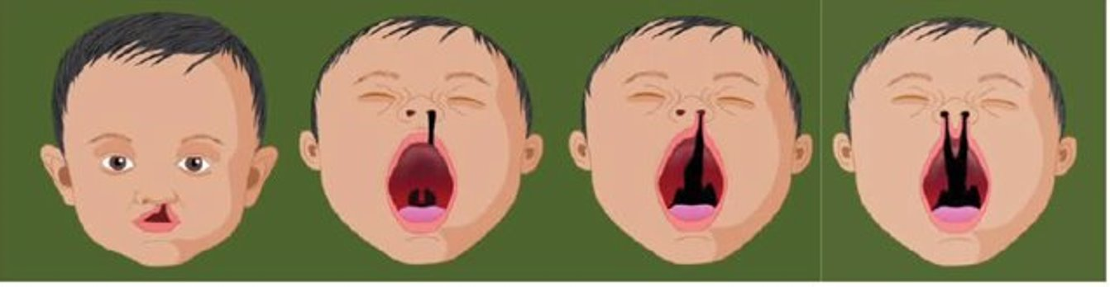

What is Cleft?
A cleft occurs when the roof of the mouth or the top lip or both doesn’t close properly during pregnancy
Clefts can be unilateral (one opening), bilateral (two openings), or a cleft palate (hole in roof of mouth)
Untreated clefts can cause difficulties eating, breathing, speaking and even hearing, which can be detrimental to a child’s development
Notes:
A cleft occurs when the roof of the mouth or the top lip (or both) doesn’t close properly during pregnancy. Clefts can be unilateral (one opening), bilateral (two openings), or affect the palate.
Untreated clefts can cause difficulties eating, breathing, speaking and even hearing, which can be detrimental to a child’s development.
Children with untreated clefts often feel isolated and can have trouble making friends.
Each year, more than 200,000 kids are born with cleft around the world, many are not able to afford surgery.

Slide 10
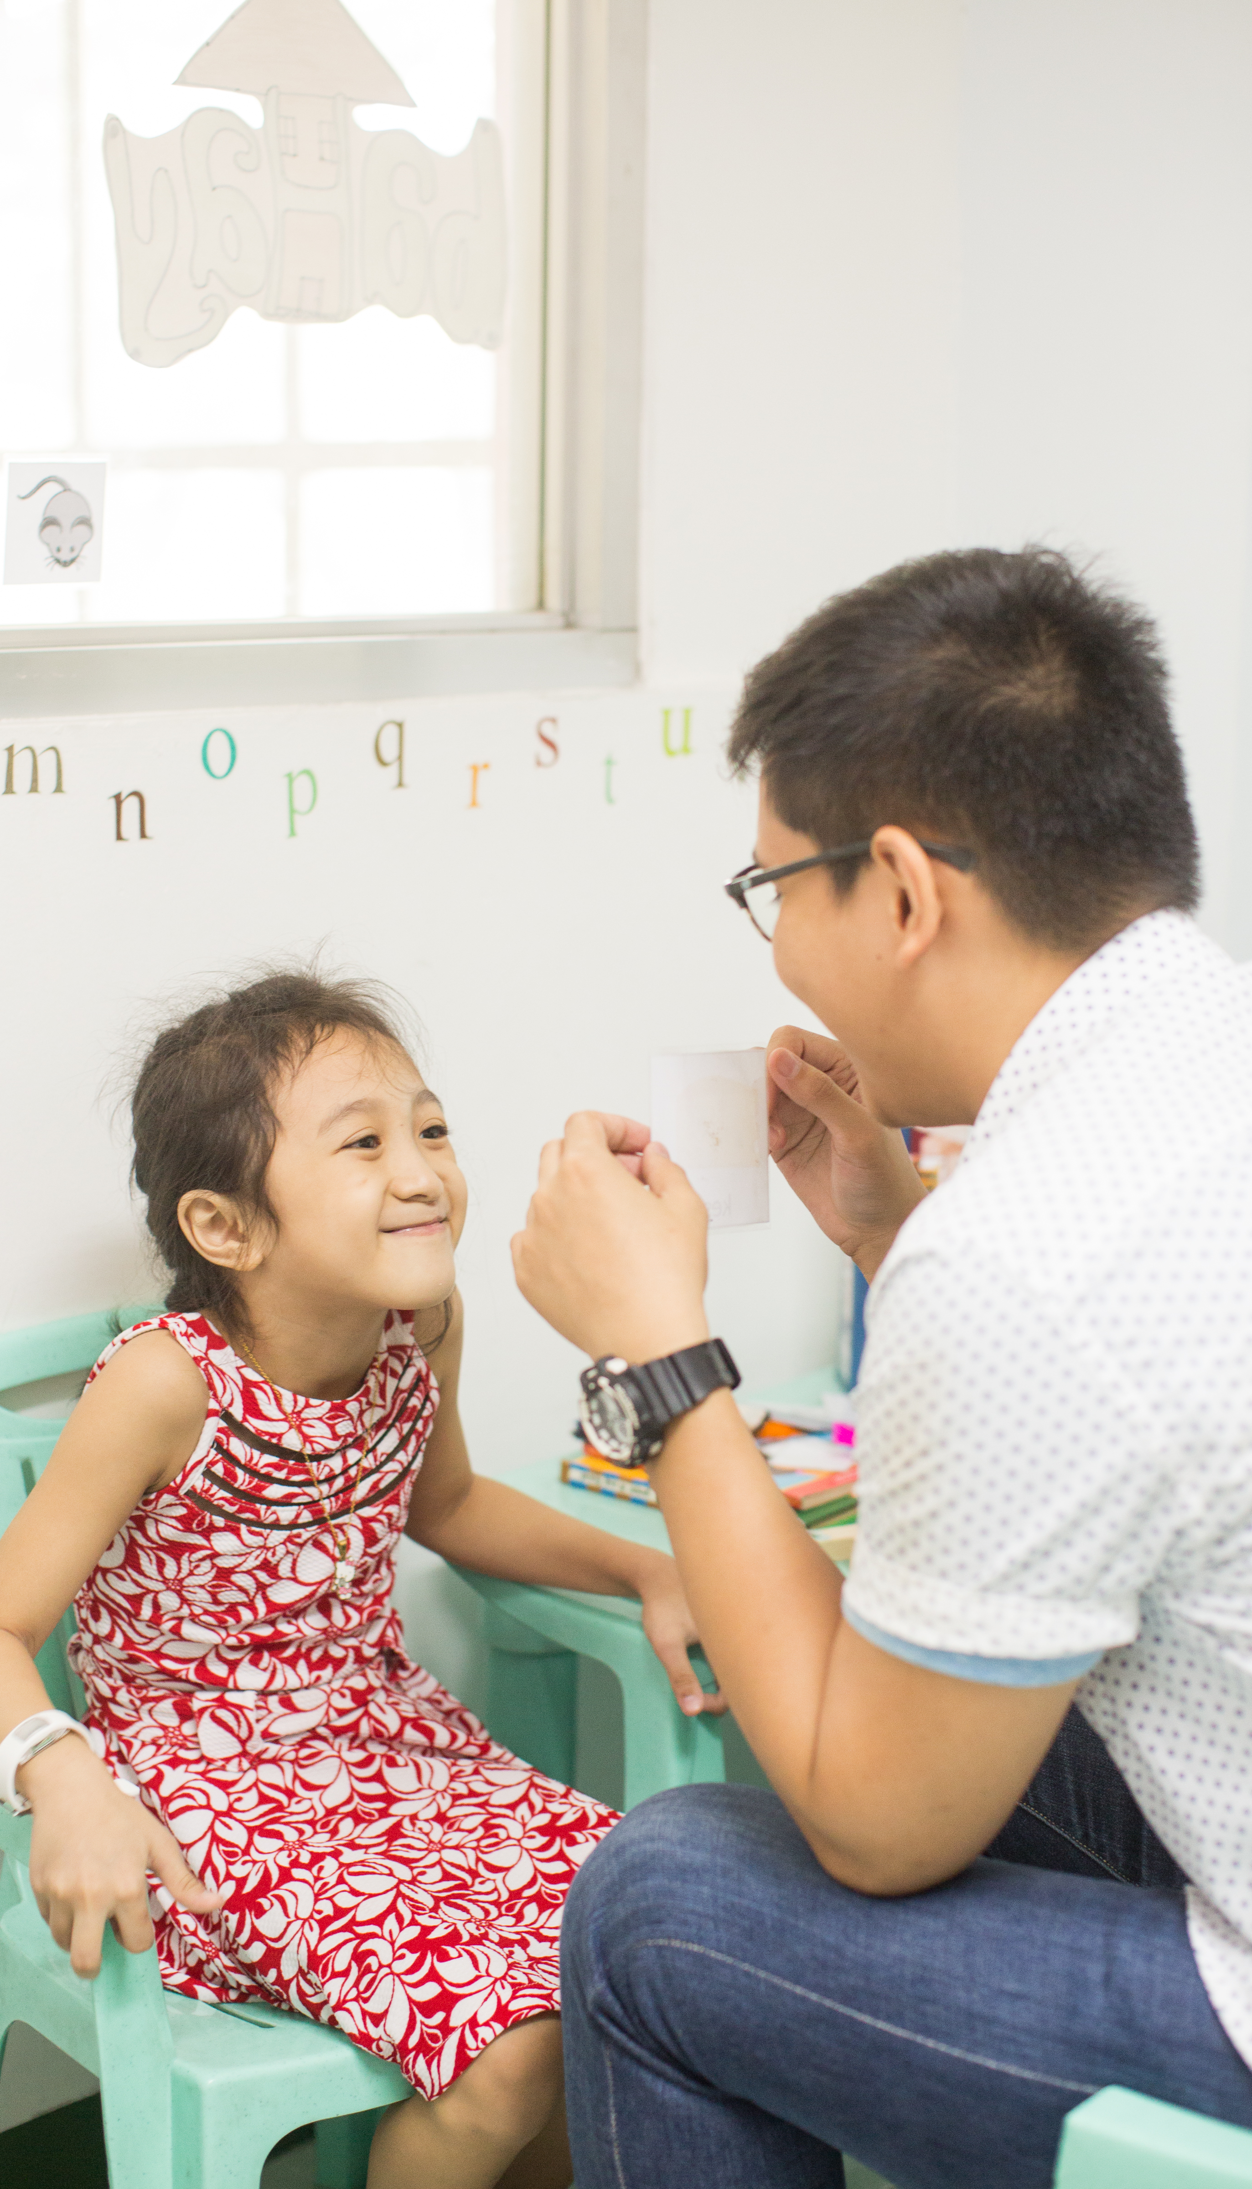
Smile Train and Nutrition
How are clefts treated?
Why is nutrition an important part of cleft care?
Notes:
Cleft is treated with surgery, but often that is not the whole story. Patients need to travel to the hospital and pre/post operative care. They might need dental or orthodontic care, speech therapy, or nutrition support.
Nutrition is important for cleft care, because patients need to be strong before they can undergo surgery. Many infants with cleft have difficulty feeding and it is very important that they don’t become malnourished. Smile Train supports programs where nurses and social workers teach mothers special techniques to help feed babies with cleft. It is important for patients to continue eating healthily after surgery so that their bodies are able to heal as well as possible! Smile Train has also developed cleft feeding videos and nutritional fliers which are shared with local communities to ensure families are empowered with the right information to keep their child healthy.

Slide 11
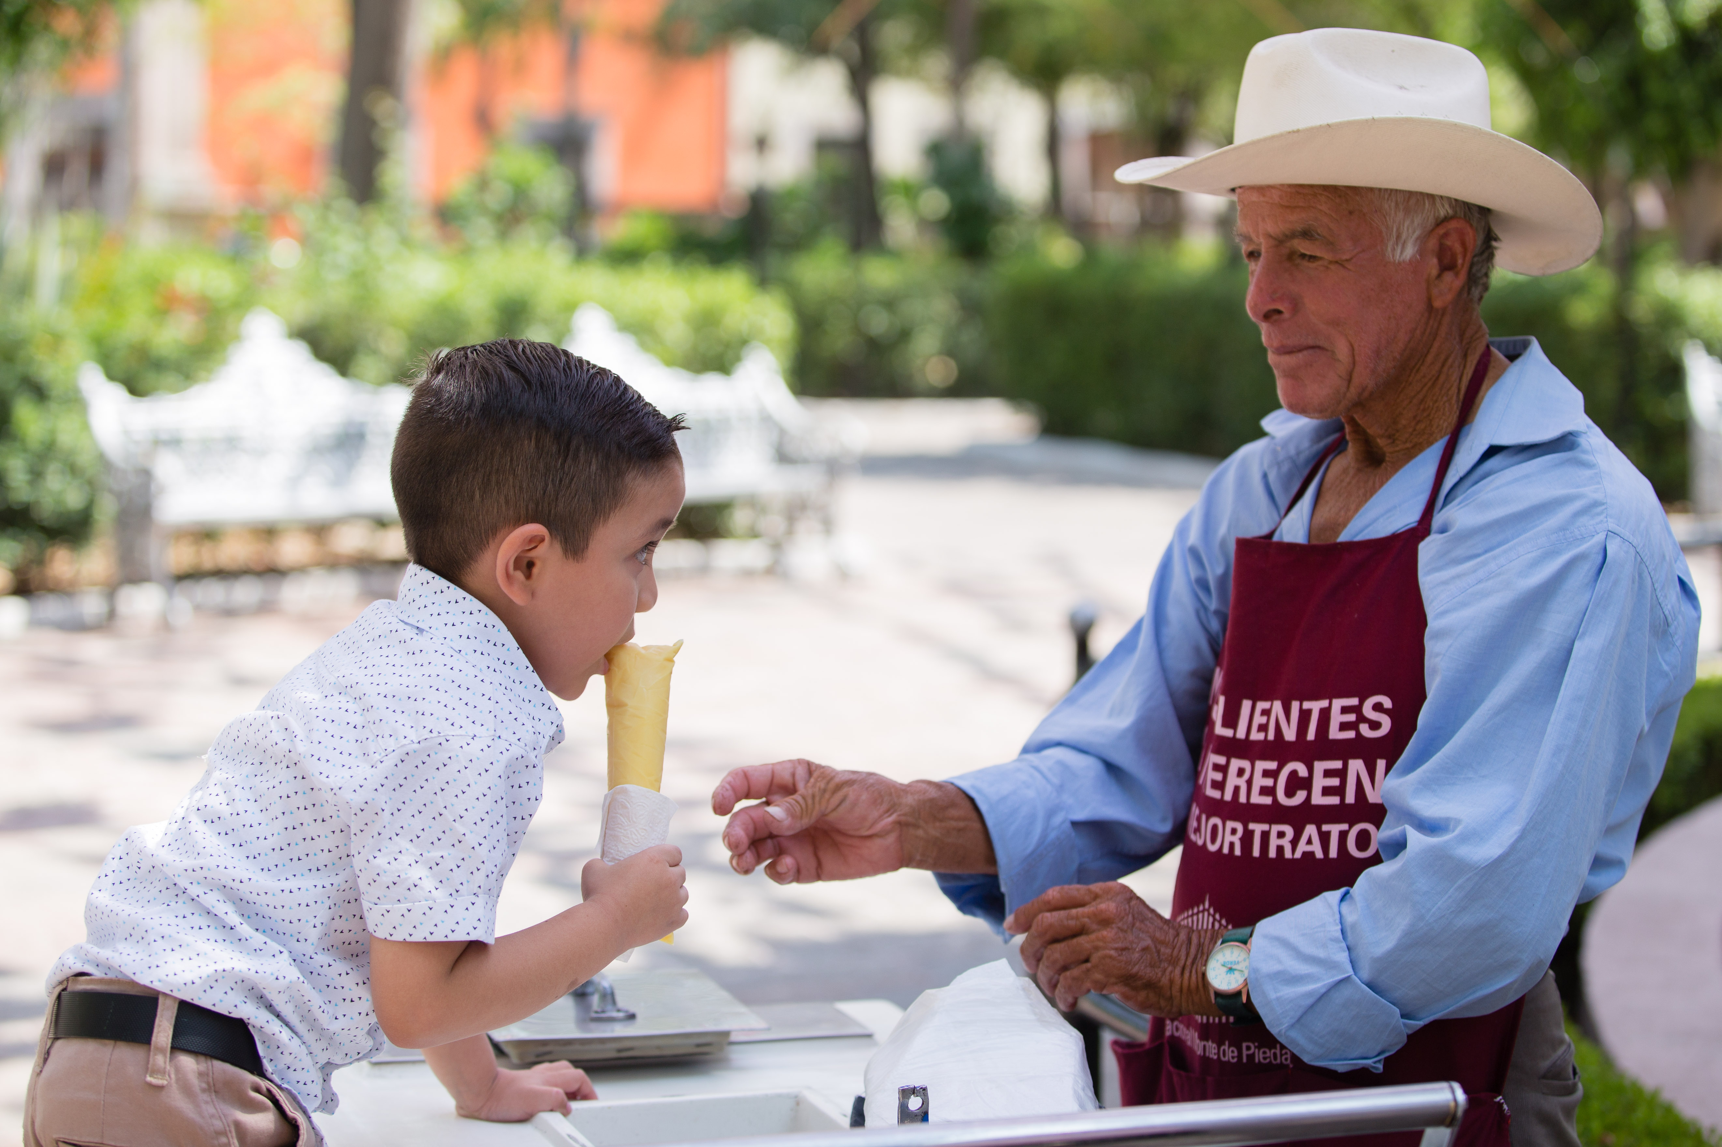
Making Connections
Notes:
This section will help reinforce the material taught in the background section.

Slide 12
Smile Train Mexico
Smile Train Mexico was founded in 2001 ​
22,000+ Smile Train-supported cleft treatments​
We have worked with 52 partner hospitals and 65 partner surgeons ​

Slide 13
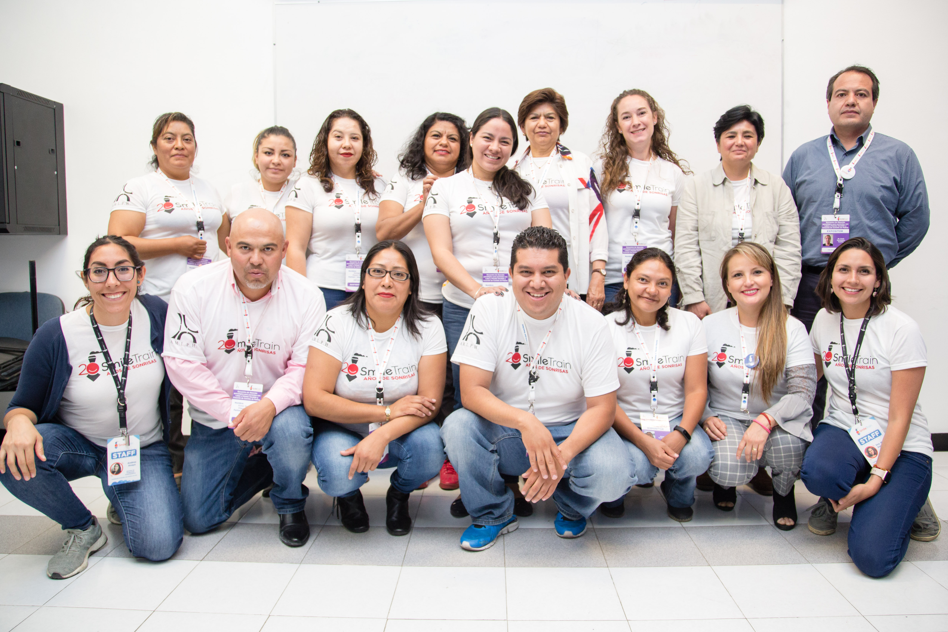
Monica – Smile Train Programs
Notes:
Monica is the Area Director for Central America and the Caribbean. She will discuss Smile Train’s programs in Mexico, tell you about some of the challenge's patients face in getting proper nutrition, and do a fun Spanish lesson for the kids! Here is a link to the video: https://www.youtube.com/watch?v=TVBG4tHhsCg&feature=youtu.be

Slide 14
Monica Spanish Lesson
Notes:
Here is a link to the stand-alone Spanish lesson: https://www.youtube.com/watch?v=znLNK4A8Ze8&feature=youtu.be

Slide 15
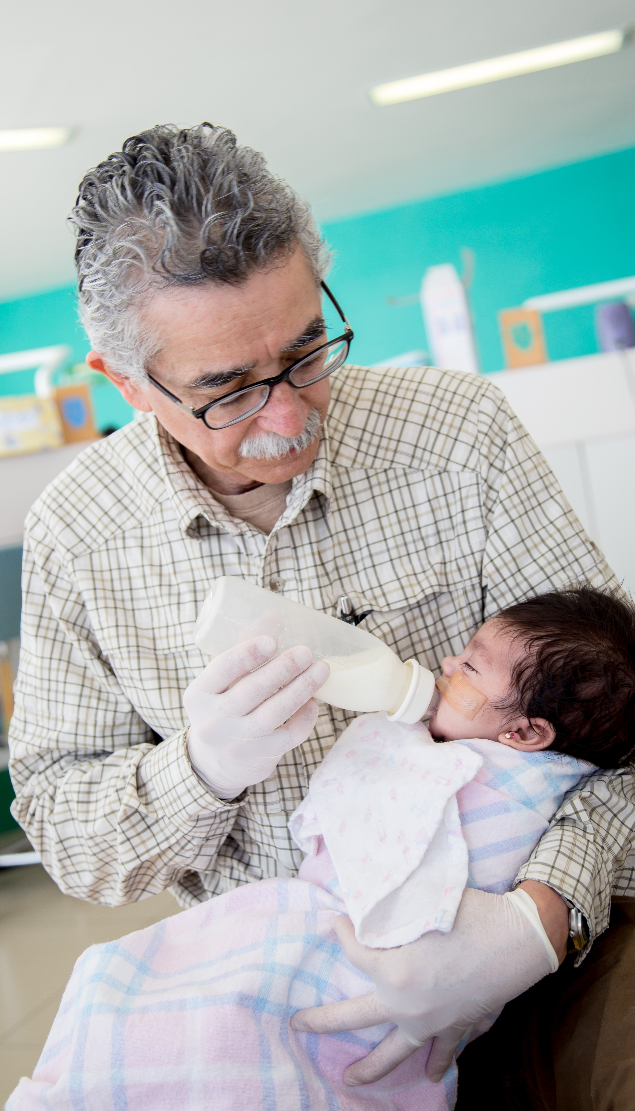
Questions for Connection
Why is calcium so important for children?
What are some vitamins and minerals you need to stay strong?
What are your favorite healthy foods?
Name some foods that make for a balanced, nutritious meal?
Why do kids need proper nutrition before having surgery?
What are three of the Spanish words you learned?

Slide 16
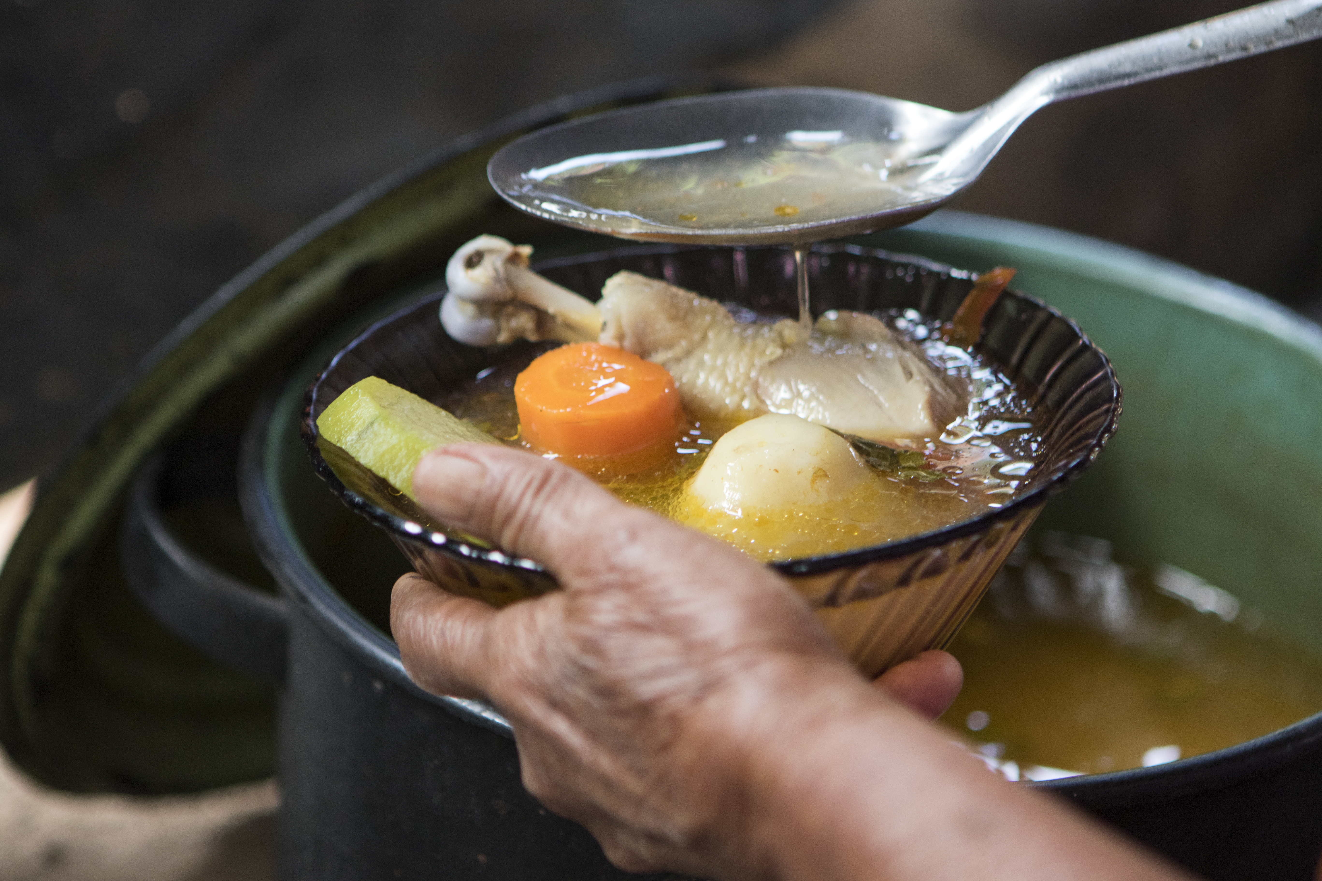
Healthy Eating Activity
Notes:
We have a great healthy eating activity for your kids to participate in. They can watch this video of two of our fabulous student ambassadors demonstrating how to make healthy fruit popsicles and then make some of their own! The recipe is in the lesson packet.

Slide 17
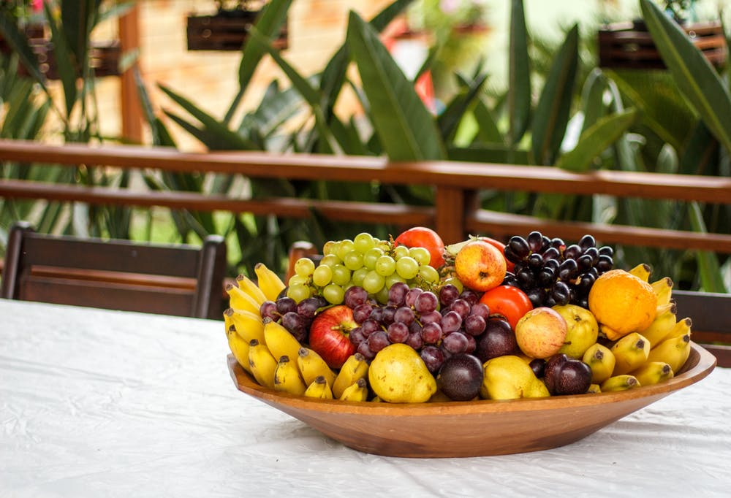
Activity Video
Notes:
Here is the link to this video: https://www.youtube.com/watch?v=kCISDea4Qic&feature=youtu.be

Slide 18
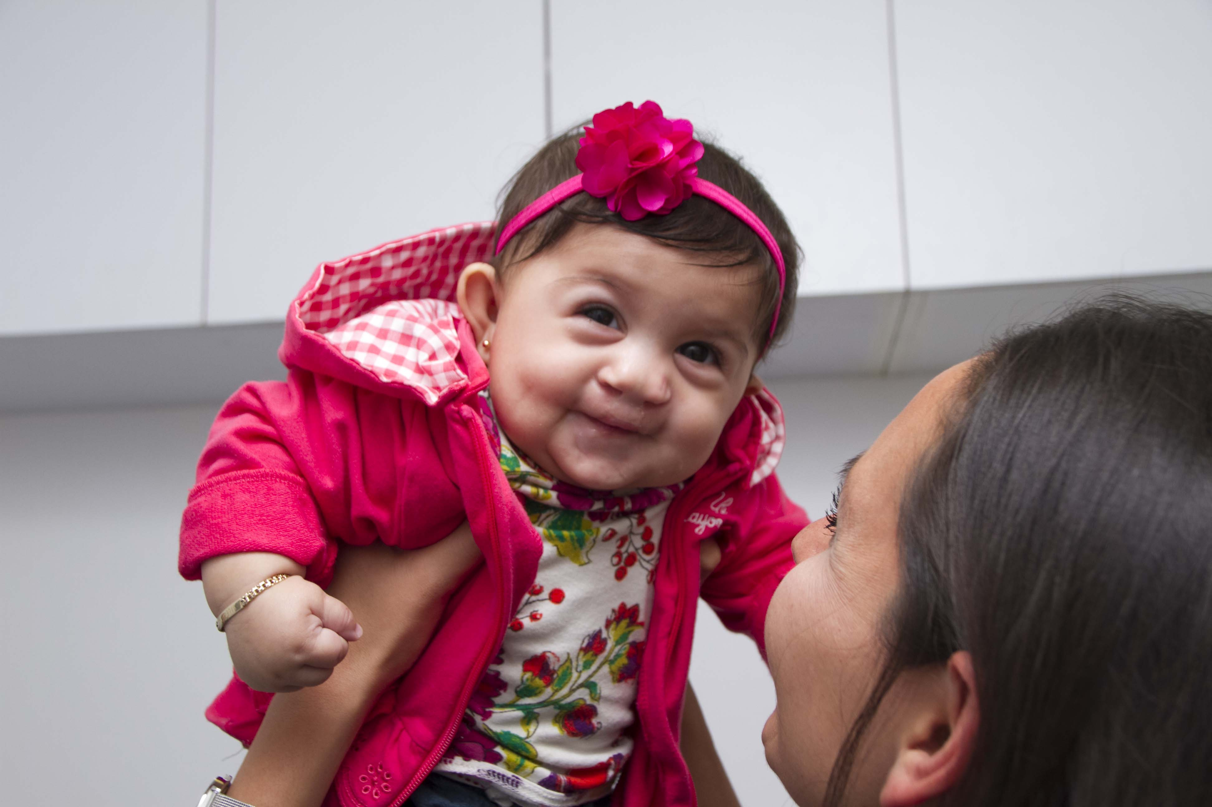
Thank You!
See you next time!

Slide 19
Sources
Smile Train. Website.
https://www.smiletrain.org/
NIH. Vitamin and Mineral Consumer Factsheets. https://ods.od.nih.gov/factsheets/list-VitaminsMinerals/.

